Slide 1


DATA
SCience
Coffee
Spoon
RWS
DATALAB
Rijkswaterstaat | Datalab | WORKSHOP | IMAGE RECOGNITION | NOV 2019
Notes:
Statistiek en computers

Slide 2
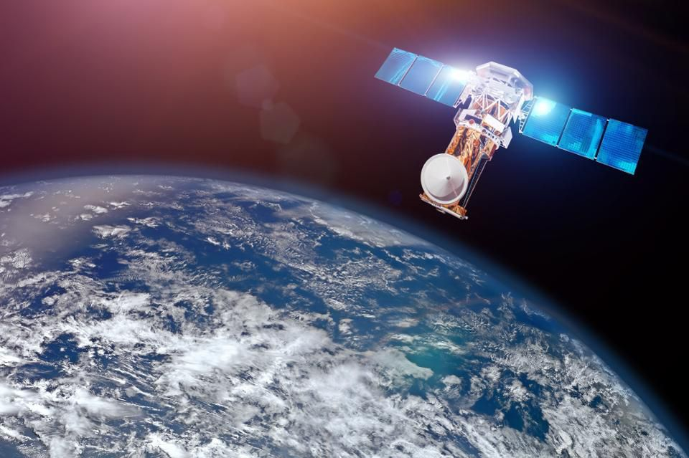
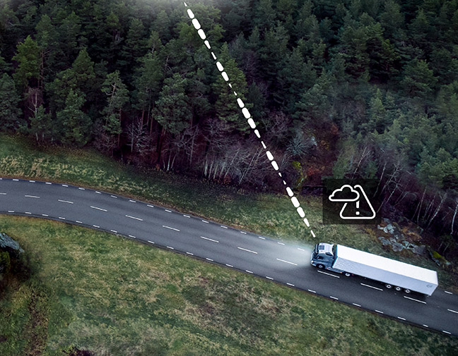
APPLICATIONS
Rijkswaterstaat

Slide 3
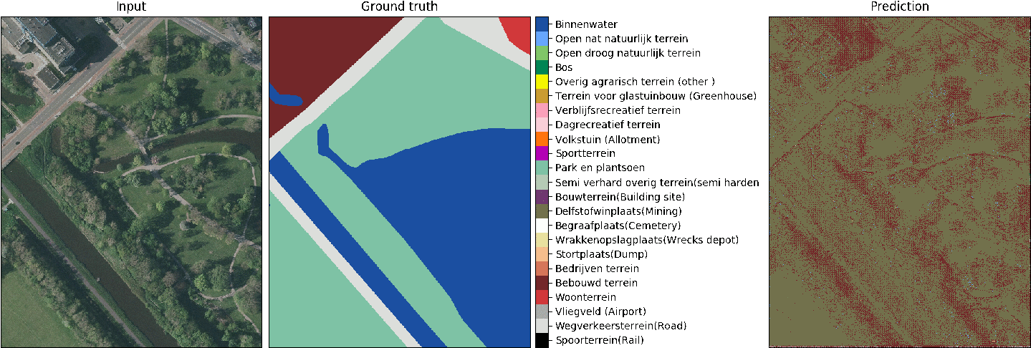
applications
Luchtfoto Landkaart van CBS
Voorspelling

Slide 4

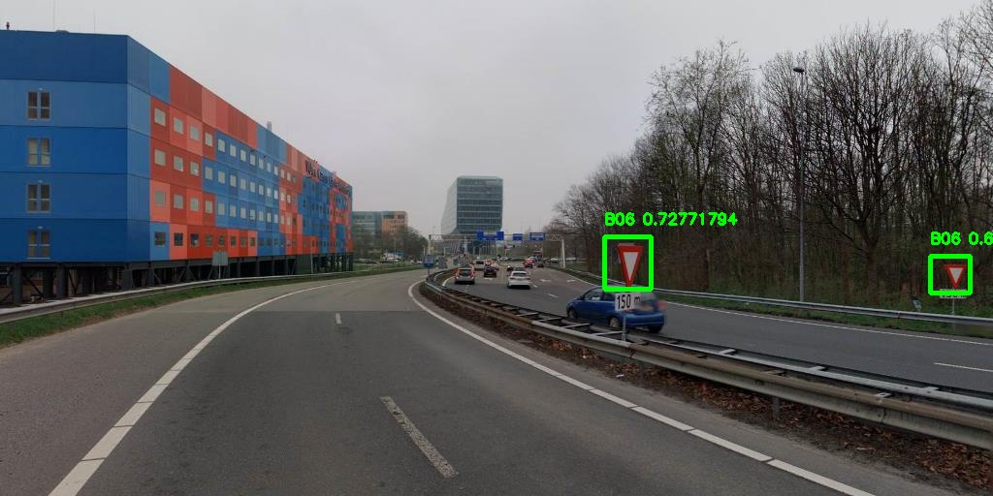
Traffic sign detection

Slide 5

Which part of ml exactly?

Slide 6
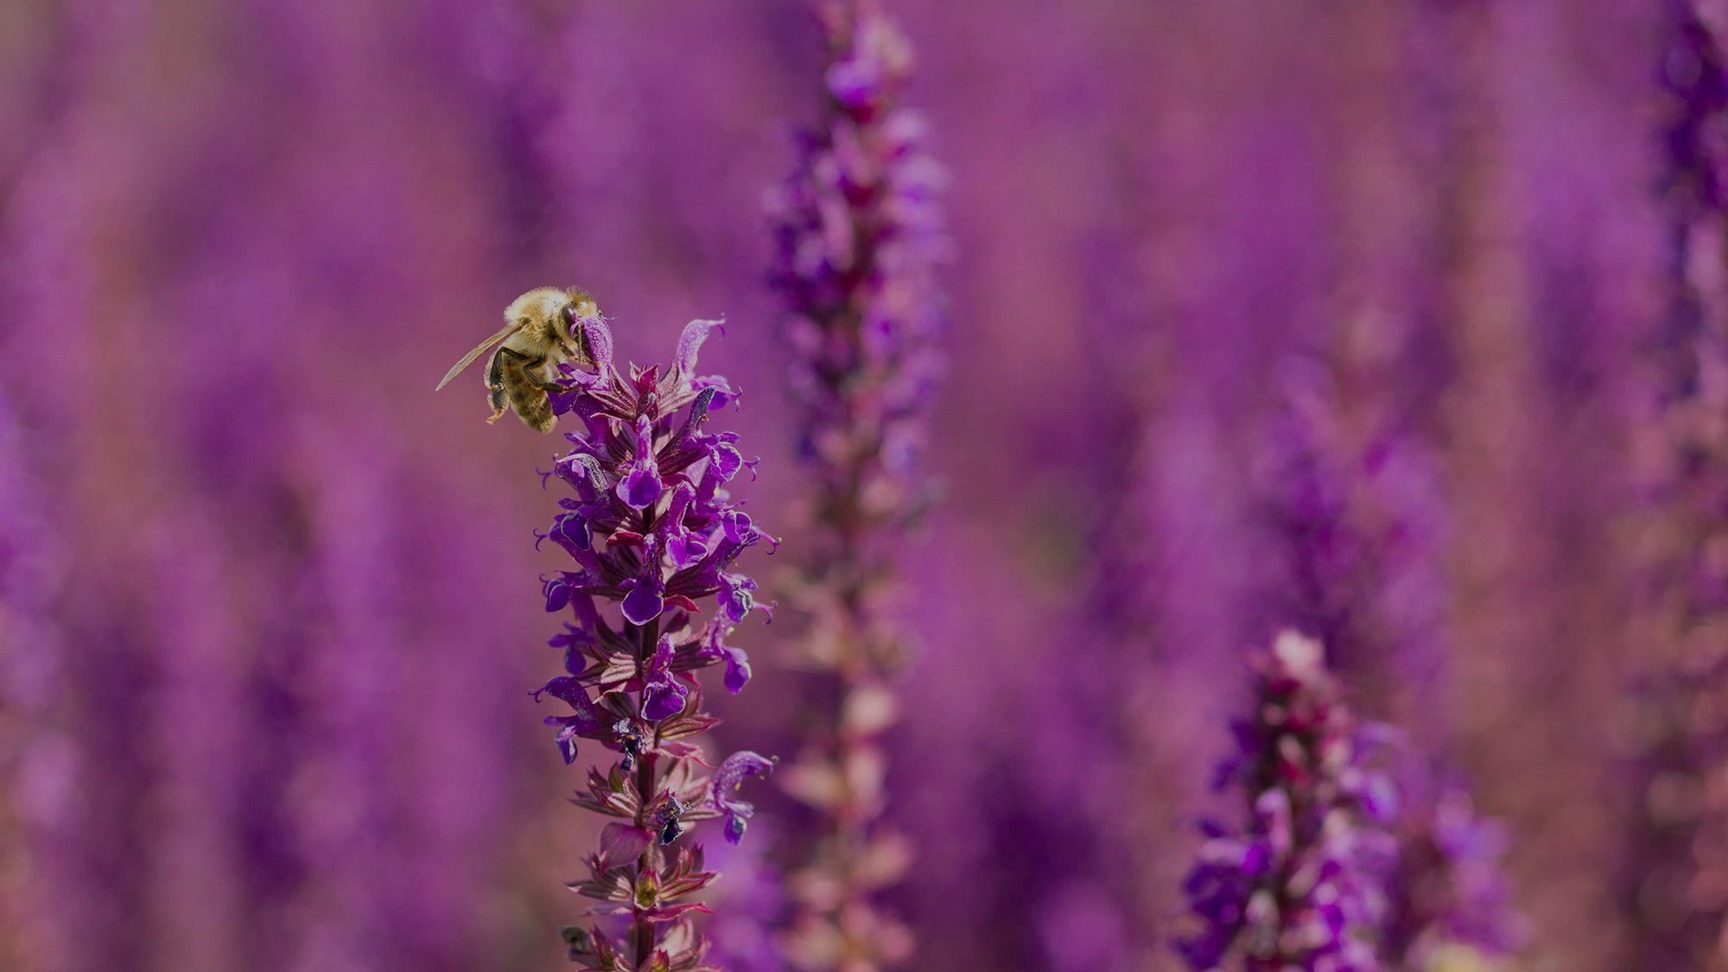

MACHINE LEARNING
SUPERVISED
(CLASSIFICATION)
UNSUPERVISED
(clustering)

Slide 7

MACHINE LEARNING
SUPERVISED
$$y=f(X)$$
output / label
input / features

Slide 8

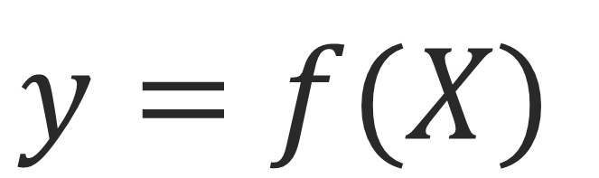
Ingredients for machine learning
zwartpixels
$$y=f(X)$$
vorm
output
input / features
kleur
$$Verkeersbord=f(zwartpixels, vorm, kleur)$$

Slide 9
How does it work?
The neuron
The activation function
How do neural networks work?
How do neural networks learn?
Backpropagation
Gradient descent

Slide 10
The neuron
X1
Input value 1
Neuron
(independent variable 1)
Processing values
Output value
X2
y
Input value 2
(independent variable 2)
Xm
Input value m
(independent variable 3)
input layer
output layer

Slide 11
The neuron
Standardize N(0,1)
X1
Input value 1
Neuron
(independent variable 1)
Processing values
Output value
X2
y
Input value 2
(independent variable 2)
Xm
Input value m
(independent variable 3)

Slide 12
The neuron
X1
Input value 1
Neuron
(independent variable 1)
Processing values
Output value
X2
y
Input value 2
(independent variable 2)
Continues
Binary (yes/no)
Categorical
Xm
Input value m
(independent variable 3)

Slide 13
The neuron
X1
Input value 1
W1
Neuron
(independent variable 1)
Processing values
Output value
X2
W2
y
Input value 2
(independent variable 2)
Wm
Continues
Binary (yes/no)
Categorical
Xm
Input value m
(independent variable 3)
How to network learns
Weights are adjusted along the way.

Slide 14
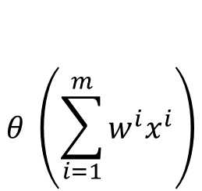
The neuron
X1
Input value 1
W1
Neuron
(independent variable 1)
$$θ \left(\sum_{i=1}^{m}{w^{i}x^{i}}\right)$$
Output value
X2
W2
y
Input value 2
(independent variable 2)
Wm
Continues
Binary (yes/no)
Categorical
Xm
Input value m
Signals are going to the neuron
The values are processed by means of the
activation function, such as weighted sum.
(independent variable 3)
How to network learns
Weights are adjusted along the way.

Slide 15
The neuron
X1
Input value 1
W1
Neuron
(independent variable 1)
$$θ \left(\sum_{i=1}^{m}{w^{i}x^{i}}\right)$$
Output value
X2
W2
y
Input value 2
(independent variable 2)
Wm
Continues
Binary (yes/no)
Categorical
Xm
Input value m
Signals are going to the neuron
The values are processed by means of the
activation function, such as weighted sum.
(independent variable 3)
How to network learns
Weights are adjusted along the way.

Slide 16
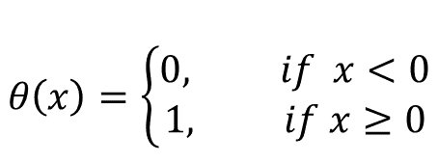
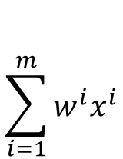
The activation function
Threshold Function
$$θ\left(x\right)=\left\{\begin{aligned}0, if x<0 \\ &1, if x≥0\end{aligned}\right.$$
1
y
0
$$\sum_{i=1}^{m}{w^{i}x^{i}}$$
0

Slide 17
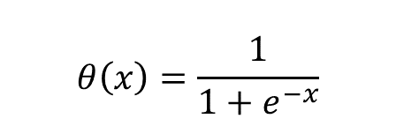
The activation function
Sigmoid Function
$$θ\left(x\right)=\frac{1}{1+e^{−x}}$$
1
y
When predicting probabilities
0
$$\sum_{i=1}^{m}{w^{i}x^{i}}$$
0

Slide 18
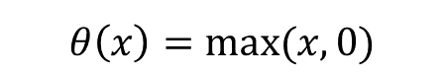
The activation function
Rectified Linear Unit (ReLU)
or Rectifier Function
$$θ\left(x\right)=max⁡(x,0)$$
1
y
One of the most used
Activation function in
neural networks
0
$$\sum_{i=1}^{m}{w^{i}x^{i}}$$
0

Slide 19
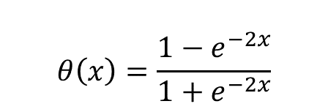
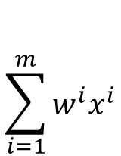
The activation function
Hyperbolic Tangent function
$$θ\left(x\right)=\frac{1−e^{−2x}}{1+e^{−2x}}$$
1
y
$$\sum_{i=1}^{m}{w^{i}x^{i}}$$
-1
0

Slide 20
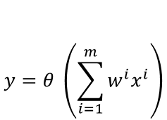
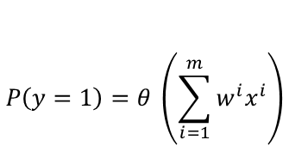
The activation function
X1
Input value 1
W1
Neuron
$$θ \left(\sum_{i=1}^{m}{w^{i}x^{i}}\right)$$
Output value
X2
W2
y
Input value 2
Wm
Xm
Input value m
$$y=θ \left(\sum_{i=1}^{m}{w^{i}x^{i}}\right)$$
If threshold activation function
$$P\left(y=1\right)=θ \left(\sum_{i=1}^{m}{w^{i}x^{i}}\right)$$
If sigmoid activation function

Slide 21
The activation function
This is a common combination
X1
Input value 1
output value
X2
y
Input value 2
Xm
Input value m
input layer
hidden layer
output layer

Slide 22
Ingredients for machine learning
zwartpixels
$$y=f(X)$$
vorm
output
input / features
kleur
$$Verkeersbord=f(zwartpixels, vorm, kleur)$$

Slide 23
How do neural networks work?
One way to learn is using a rule based approach
Traffic sign 50kmh:
Black pixels should be more then [x], and
shape should be like [y or z],
and color should be like [k]
We do not want to do this but let the model figure out how to decide.

Slide 24
How do neural networks work?
X1
shape
W1
Traffic sign=w1*x1+w2*x2+w3*x3
X2
W2
y
color
W3
X3
Black pixels
The accuracy comes by
using the hidden layers
input layer
output layer

Slide 25
How do neural networks work?
X1
shape
output value
X2
y
color
X3
Black pixels
input layer
hidden layer
output layer

Slide 26
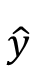
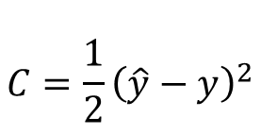
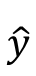
How do neural networks learn?
X1
shape
W1
$$\hat{y}$$
y
C
$$θ \left(\sum_{i=1}^{m}{w^{i}x^{i}}\right)$$
X2
W2
color
$$\hat{y}$$
Output value
$$C=\frac{1}{2}{\left(\hat{y}−y\right)}^{2}$$
(cost function)
W3
X3
y
Black pixels
Real value
Weights get updated
We only have control on the weights in this simple model

Slide 27
How do neural networks learn?
X1
shape
y
W1
$$\hat{y}$$
y
$$\hat{y}$$
C
C
$$θ \left(\sum_{i=1}^{m}{w^{i}x^{i}}\right)$$
X2
W2
color
$$\hat{y}$$
Output value
$$C=\frac{1}{2}{\left(\hat{y}−y\right)}^{2}$$
(cost function)
W3
X3
y
Black pixels
Real value
Cost function is adjusted

Slide 28
How do neural networks learn?
X1
shape
W1
$$\hat{y}$$
y
C
$$θ \left(\sum_{i=1}^{m}{w^{i}x^{i}}\right)$$
X2
W2
color
$$\hat{y}$$
Output value
$$C=\frac{1}{2}{\left(\hat{y}−y\right)}^{2}$$
(cost function)
W3
X3
y
Black pixels
Real value
Weights get updated
Cost function is adjusted

Slide 29
How do neural networks learn?
X1
shape
y
W1
$$\hat{y}$$
y
$$\hat{y}$$
C
C
$$θ \left(\sum_{i=1}^{m}{w^{i}x^{i}}\right)$$
X2
W2
color
$$\hat{y}$$
Output value
$$C=\frac{1}{2}{\left(\hat{y}−y\right)}^{2}$$
(cost function)
W3
X3
y
Black pixels
Real value
Cost function is adjusted
This process is called Backpropagation

Slide 30

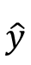
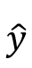
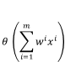
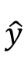
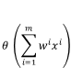
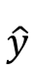
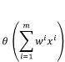
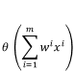
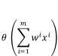
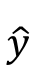
How do neural networks learn?
Row | Color | Shape | Black pixels | Y
1 | 255 | 1=round | 5 | Stop
2 | 250 | 1=round | 2 | Stop
3 | 90 | 2=square | 90 | 50sign
4 | 20 | 1=round | 110 | 50sign
5 | 25 | 2=square | 125 | 50sign
… | … | … | … | …
n | … | … | … | …
X1
X1
X2
$$θ \left(\sum_{i=1}^{m}{w^{i}x^{i}}\right)$$
X2
$$θ \left(\sum_{i=1}^{m}{w^{i}x^{i}}\right)$$
$$\hat{y}$$
$$\hat{y}$$
X3
y
X3
y
X1
X1
X2
$$θ \left(\sum_{i=1}^{m}{w^{i}x^{i}}\right)$$
X2
$$θ \left(\sum_{i=1}^{m}{w^{i}x^{i}}\right)$$
$$\hat{y}$$
$$\hat{y}$$
X3
y
X3
y
X1
X2
$$θ \left(\sum_{i=1}^{m}{w^{i}x^{i}}\right)$$
$$\hat{y}$$
X3
y
$$\hat{y}$$
y
$$\hat{y}$$
y
$$\hat{y}$$
y
$$\hat{y}$$
y
$$\hat{y}$$
y

Slide 31
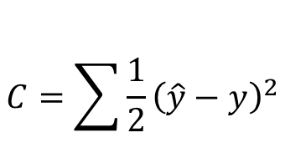
How do neural networks learn?
Row | Color | Shape | Black pixels | Y
1 | 255 | 1=square | 5 | Stop
2 | 250 | 1=square | 2 | Stop
3 | 90 | 2=round | 90 | 50sign
4 | 20 | 2=round | 110 | 50sign
5 | 25 | 2=round | 125 | 50sign
… | … | … | … | …
n | … | … | … | …
X1
X1
X2
$$θ \left(\sum_{i=1}^{m}{w^{i}x^{i}}\right)$$
X2
$$θ \left(\sum_{i=1}^{m}{w^{i}x^{i}}\right)$$
$$\hat{y}$$
$$\hat{y}$$
X3
y
X3
y
X1
X1
X2
$$θ \left(\sum_{i=1}^{m}{w^{i}x^{i}}\right)$$
X2
$$θ \left(\sum_{i=1}^{m}{w^{i}x^{i}}\right)$$
$$\hat{y}$$
$$\hat{y}$$
X3
y
X3
y
X1
Update Weights
$$θ \left(\sum_{i=1}^{m}{w^{i}x^{i}}\right)$$
Note that all the rows share the weight, w1, w2, w3!
X2
$$\hat{y}$$
X3
y
$$C=\sum{\frac{1}{2}{\left(\hat{y}−y\right)}^{2}}$$
One full round of optimization is called: Epoch
$$\hat{y}$$
y
$$\hat{y}$$
y
$$\hat{y}$$
y
$$\hat{y}$$
y
$$\hat{y}$$
y
C
Notes:
In order to let the neural network learn, the weights needs to get updated, the cost function needs to get lower

Slide 32
Gradient descent
In order to let the neural network learn, the weights needs to get updated, the cost function needs to get lower
The question is: How can we minimize the cost function?
Brute force is way of trying all possible combinations of weights
A smart way is using a function where we do not need to search in the whole space; gradient descent

Slide 33
But what are the input values for an image?
X1
pixel1
y
W1
$$\hat{y}$$
y
$$\hat{y}$$
C
C
$$θ \left(\sum_{i=1}^{m}{w^{i}x^{i}}\right)$$
X2
W2
pixel2
$$\hat{y}$$
Output value
$$C=\frac{1}{2}{\left(\hat{y}−y\right)}^{2}$$
(cost function)
W3
X3
y
pixel3
Real value
Cost function is adjusted

Slide 34
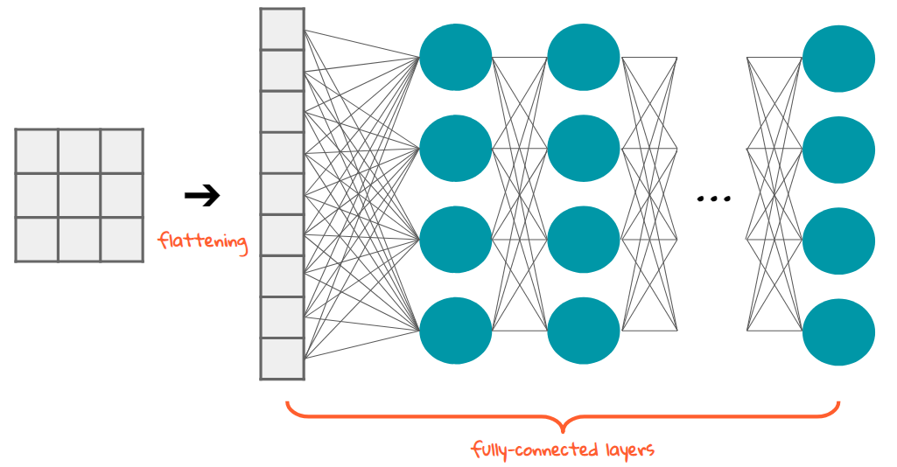













convolution
Neuraal netwerk
Features (nodes)
Input image
Output image
Voorspelling

Slide 35



Steps to take
1. Data-preparatie: maken van een train- en testset (afbeeldingen, labels)
verleen voorrang
maximumsnelheid
slecht wegdek
beelden verzamelen
beelden labelen

Slide 36
Steps to take
2. Trainen om een model te genereren:
Training kan meerdere dagen duren op DGX (8 GPUs)
Meerdere keren model genereren om te kijken wat de beste parameters zijn

Slide 37
workshop
Traffic sign detection

Slide 38

workshop
Verkeersborden herkennen d.m.v. neuraal netwerk
- Afbeeldingen inladen (en bekijken)
- Neuraal netwerk maken en trainen
- Het model toepassen op de testafbeeldingen

Slide 39
workshop
1. Ga naar: bit.ly/rwszelfdoen
2. Open een terminal en typ regel voor regel in:
cd Documents
cd traffic-signs-tensorflow
source activate tensorflow-tutorial
jupyter notebook
Er opent zich een homescherm van Jupyter, open 1) Verkeersborden Classificeren
wifi-netwerk: wachtwoord:

Slide 40
assignment
1. Lees de tekst aandachtig door.
2. Wanneer je bij een programmeerblokje aan komt:
Klik je op het programmeerblokje.
Vervolgens druk je op run (bovenaan).
Wacht even en kijk wat er gebeurt.
Is het programmeerblokje gerund? Ga dan naar het volgende programmeerblokje.

Slide 41
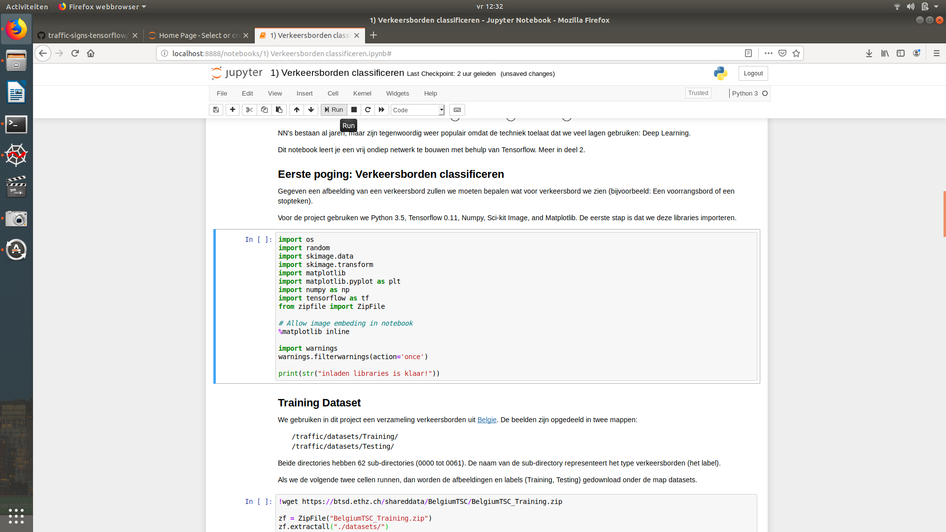
Jupyter notebook
Druk op: run
Selecteer het programmeerblokje

Slide 42
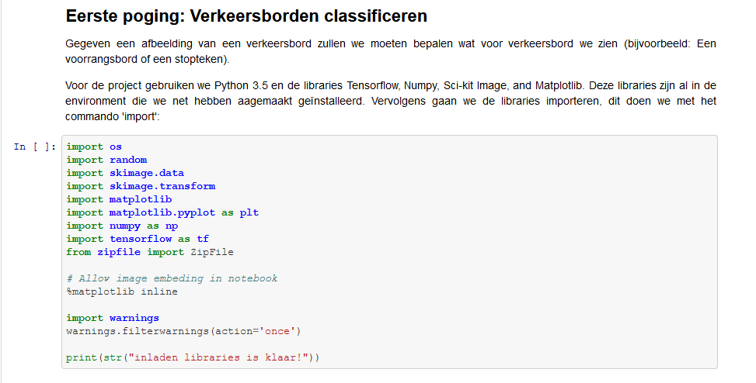

Getting started
Eerste 5 minuten:
- Importeren libraries
- Traindata inladen

Slide 43
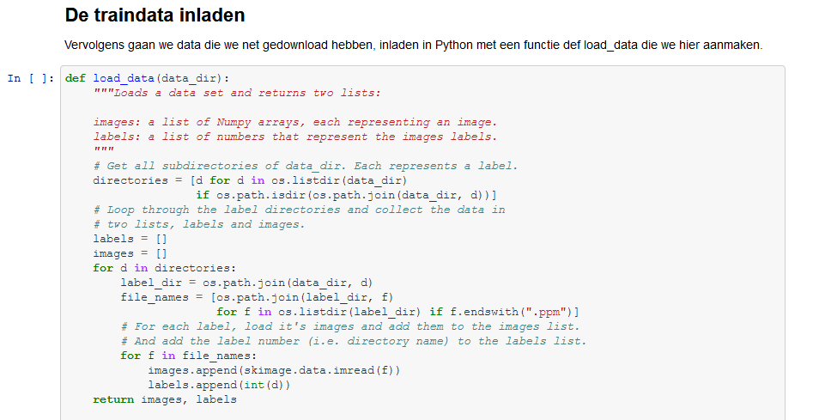
Steps to take
Tweede 5 minuten:
Traindata inladen
De data verkennen
Vraag: Verander in de cel met functie: def display_label het getal 42 in een ander getal tussen de 1 en de 61. Wat zie je gebeuren??

Slide 44
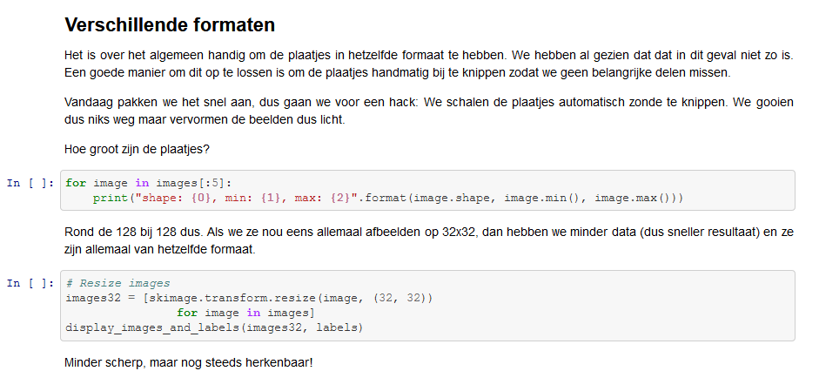
Steps to take
Derde 5 minuten:
Verschilende formaten
Bij iedereen gelukt??

Slide 45
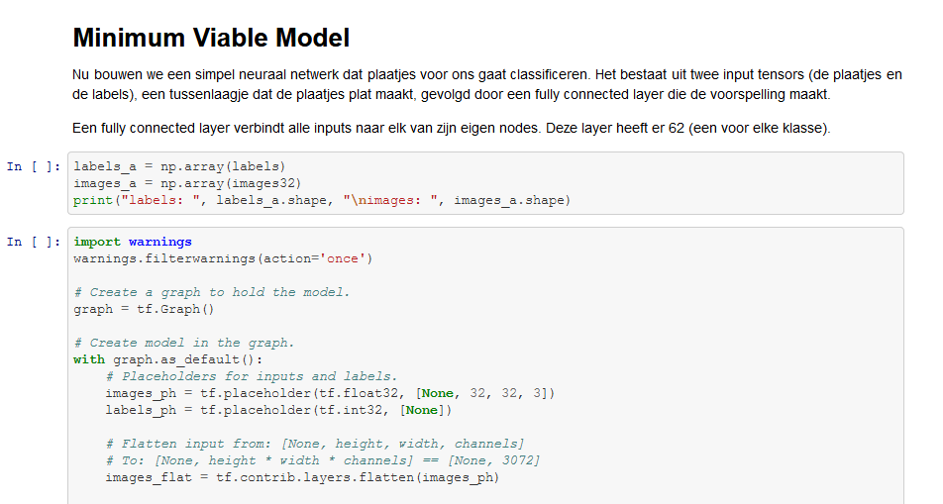
Steps to take
Vierde 5 minuten:
Minimum Viable Model
Bij iedereen gelukt?

Slide 46
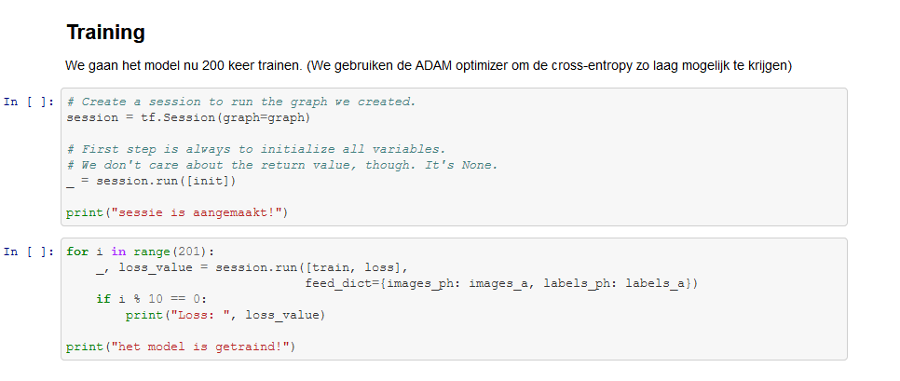
Steps to take
Vijfde 5 minuten:
Trainen van het model
Vraag:
- Verander in de cel dat begint met for i in range(201).., onder het kopje training, de 10 in een groter of kleiner getal.
Verander de 201 in een ander getal.
Wat zie je bij beide veranderingen gebeuren?

Slide 47
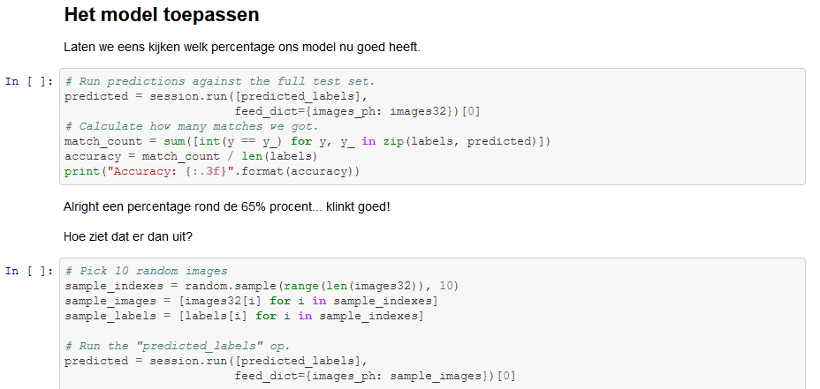
Steps to take
Zesde 5 minuten:
Het model toepassen op train-afbeeldingen
Vraag:
Wat is het percentage nauwkeurigheid dat eruitkomt?

Slide 48
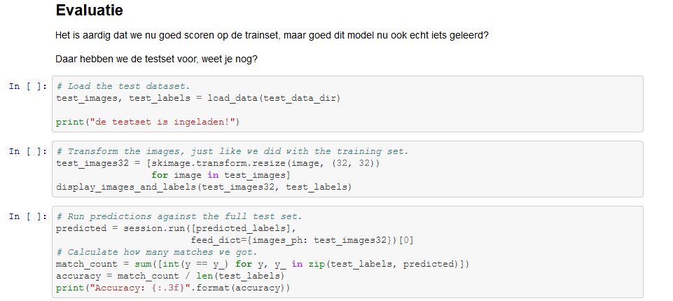
Steps to take
Zevende 5 minuten:
Het model toepassen op test afbeeldingen.
Vraag:
- Wat is het percentage nauwkeurigheid dat eruitkomt?
- Wat is het verschil met de vorige keer?

Slide 49
final
Eindvraag:
Probeer de resolutie van de afbeeldingen te verhogen, in de cel dat begint met ‘# resize image’ en vervolgens opnieuw te trainen.
Wat zie je met de loss gebeuren? Hoe kan je dat verklaren?

Slide 50
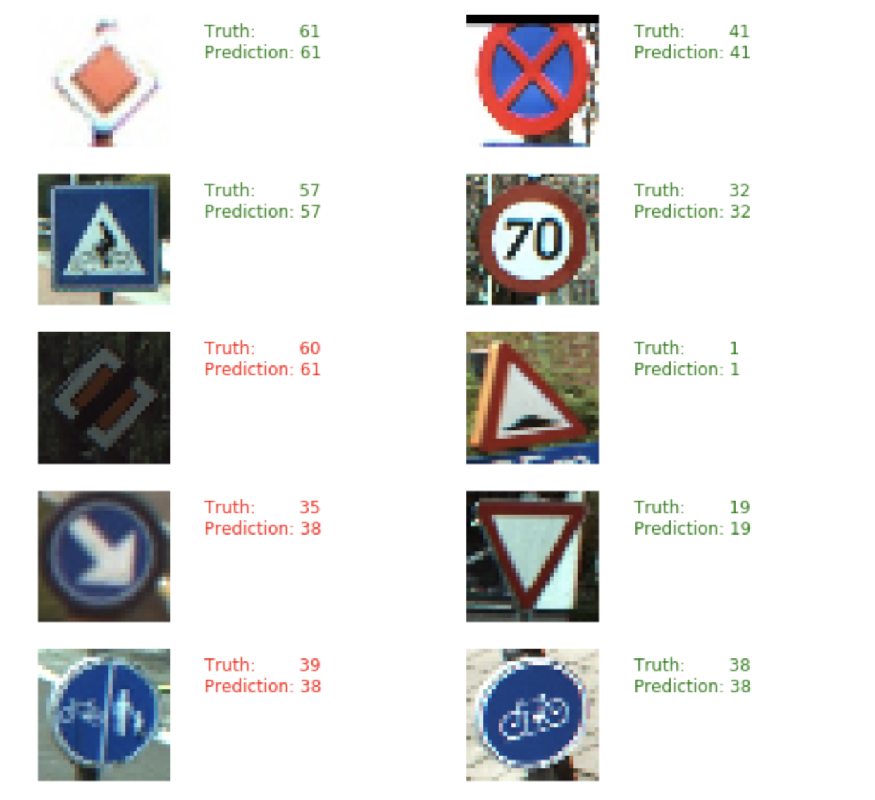
evaluation
Voorspelling doen van object op afbeelding, klinkt dit logisch?

Slide 51
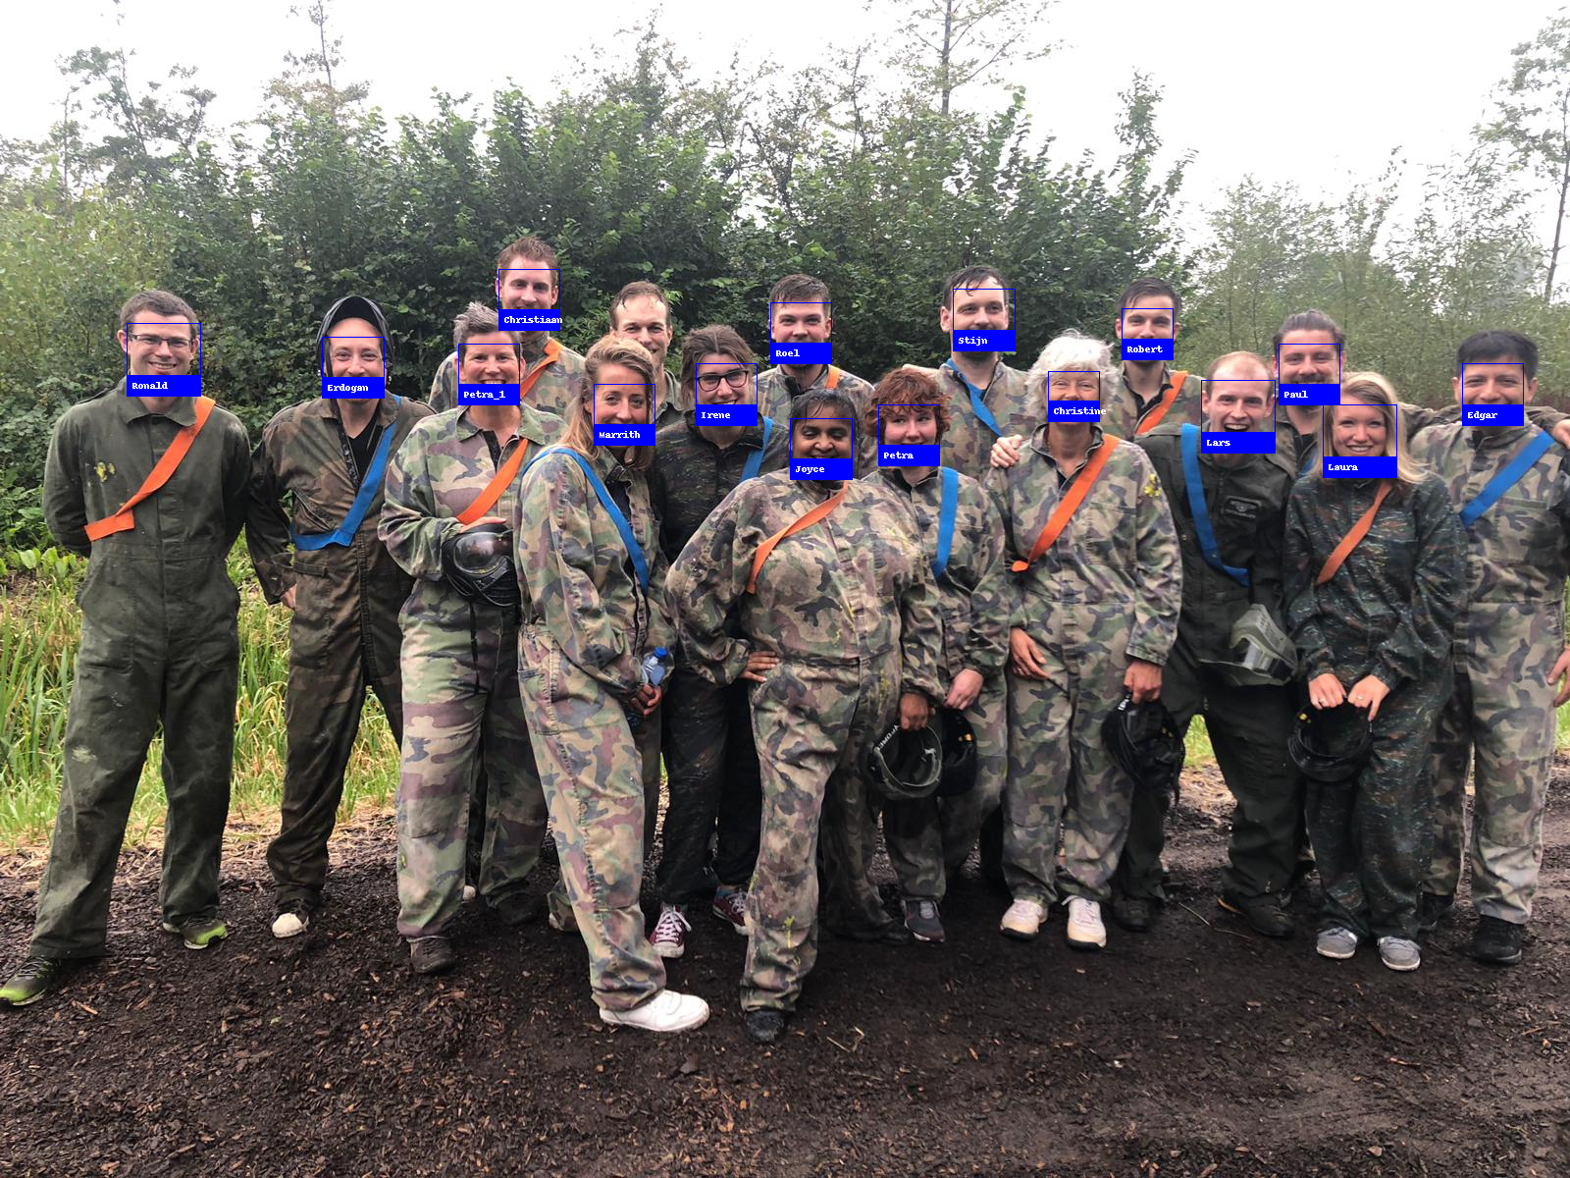
Datalab @ Rijkswaterstaat
$$facei=SVM\left(HOG(FACES\left(RGB\right))\right)$$

